Slide 1


NON-REVENUE WATER MANAGEMENT WORKSHOP
FOR ISWSC
ON
“DEVELOPING A STRATEGIC INTENT TO REDUCE AND MANAGE NON-REVENUE WATER”
BY
By Engr. Adiruo Oluchuckwu_{MNSE,MNAHS}
(Head of Water Services Department (ISWSC)
VENUE:
Imo State Water and Sewerage Corporation Conference Hall
100 days action plan
29th, APRIL 2022.

Slide 2
FOOD FOR THOUGHT
Insanity is to keep doing the same thing and expecting different result
A salary earning staff of an utility that is not effective or efficient in his or her duty is a contributory factor to NRW.
The greatest history in Nigeria will be when poverty is consigned in the museum
The greatest threat to our environment is the belief that someone else we save it.
Highly successful organizations are innovators
The level attained by great men was not by sudden flight.
Your attitude determines your altitude in life
It is Never too late to be what you might have been.

Slide 3
FACTS ABOUT WATER
Water is 2nd most essential need of man.
No life form can exist without the sustenance of water.
Over 2/3rd of the earth's surface is covered by water.
Water is needed for domestic purposes, industrial, agricultural and recreational purposes.
Life will become unbearable without adequate water supply.
Man needs water in certain quantity and quality
Thousands have lived without love, but one without water

Slide 4
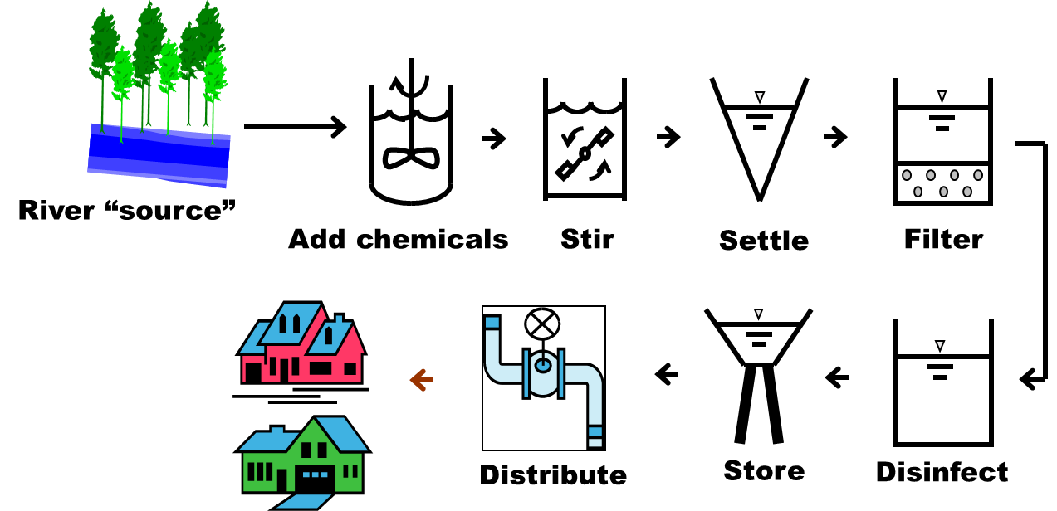
Water Treatment Process

Slide 5
INTRODUCTION
The NRW challenge can only be properly understood after NRW and its components are quantified, the appropriate performance indicators calculated, and the lost water volume is translated into its corresponding economic value.
Development of the water balance reveals the magnitude of each NRW component.
This presentation discusses how to identify the major NRW components and develop a companywide strategy to reduce targeted components

Slide 6
ESTABLISHING THE STRATEGIC INTENT DEVELOPMENT TEAM
The NRW reduction strategic team ensures that all components of NRW are covered and that the proposed strategy is feasible in terms of physical application and financial requirements.
The team should comprise of members from each operational department, including production, distribution, and customer service.
It may also include members from the finance, procurement, and human resource departments.
Choosing the right members promotes ownership by ISWSC various departments involved in the strategic intent implementation, and also ensure consensus by senior management.

Slide 7
IMPORTANCE OF SETTING APPROPRIATE NRW REDUCTION TARGETS
The strategic intent development team should first set the corporation’s -wide target for NRW reduction.
Identifying the economic level of NRW is essential to setting the initial NRW target
Two components that must be determined are the cost of water lost and the cost of NRW management:
The cost of water lost is the value of the water lost through-both physical and commercial losses. The volume of physical losses should be multiplied by the variable operational costs, including manpower, chemicals, and electricity.
The volume of commercial losses should be multiplied by the average customer tariff.
As NRW increases, the cost of water lost increases proportionally.
The cost of NRW management is the cost of reducing NRW, including staff costs, equipment transportation, and other factors. As NRW decreases, the cost of NRW management increases.

Slide 8
PRIORITISING NRW REDUCTION COMPONENTS
Once the Corporation-wide NRW target is set, Production managers should calculate the proposed volume of water saved by comparing the NRW baseline with the target level.
The various components, as detailed in the water balance, are then prioritized according to how the required total reduction can be most cost effectively achieved.
Where a water utility has a shortage of treated water, reduction in physical losses would effectively create additional water supply.
If increasing water supply is the objective, then prioritizing physical losses could enable more customers to receive water, or for new customers to be connected to the supply system

Slide 9
BASIC PREMISE OF NRW REDUCTION STRATEGIC INTENT-TOLL FREE LINE, AWARENESS, LOCATION, AND REPAIR (TALR)
Once the ISWSC NRW target is set and the different components analyzed to prioritize areas for achieving the desired reduction, then individual activities will be identified.
The development of the strategic intent should be based on the concept of Toll Free Lines, Awareness, Location, and Repair, or TALR. This concept states that any loss occurring from leaks, overflows, faulty customer meters, or other sources will have Four stages.
  Toll Free Lines – Call informing the utility about leakages
  Awareness time—time required for the utility to become aware of the leak.
  Location time—time required to locate the leak.
  Repair time—time required to repair the leak.

Slide 10
THE EFFECT OF TIME ON THE TOTAL VOLUME LOST
Water loss will continue to increase until the corporation is informed and be aware of the problem, locates it, and finally repairs or resolves it.
NRW strategic intent must ensure that the corporation reduces its TALR times for all NRW components.
Many losses occur because of poor or limited maintenance, so in addition to reducing TALR, a Fifth element of the NRW strategic intent should be system maintenance. This is critical to maintaining good asset condition and reducing the incidence of new leaks, meter failures, reservoir leaks, and other problems.
When developing an NRW management strategic intent, remember that reducing NRW is not a short-term process, especially in aging, large, open, or high pressure systems.
NRW strategies spanning between four and seven years are reasonable

Slide 11
BUDGET CONSIDERATIONS FOR IMPLEMENTING THE STRATEGY
The development and implementation of activities to achieve the targeted level of NRW incurs a financial cost
Undertaking pilot projects to demonstrate the effectiveness of the NRW strategic intent is useful. The budget should identify the following costs:
  Staffing – include staff for both direct NRW works (e.g leakage technicians) and indirect support (e.g procurement staff)
  Equipment
  Vehicles – include transportation costs, which can become an important issue in maximising the work rate of all staff.
  Works – include the cost for installing all equipment, such as meter and pressure reducing valves, and also detecting and repair all leaks.

Slide 12
BENEFIT OF NRW WATER REDUCTION IN ISWSC
Reduce water losses
Financial Improvement and viability
Increase knowledge of the distribution system
More efficient use of existing supplies
Reduced Property Damage
Improve Public Relation
Reduced Legal Liability
Reduce contamination on distribution line

Slide 13
Key Messages
The NRW reduction strategic intent team ensures that all components of NRW are covered and that the proposed strategic intent is feasible in terms of physical application and financial requirements.
Choosing the right members promotes ownership by the various departments involved in the strategic intent implementation, and also ensure consensus by senior management.
Identifying the economic level of NRW should be the basis for setting the initial corporations-wide target for NRW reduction.
Using the water balance to prioritize components for NRW reduction helps balance the financial and water supply objectives of the NRW strategic intent.
The NRW reduction strategy should aim to reduce the TALR times
NRW reduction is a long-term process and the strategy may cover a period of 4- 7 years.
Pilot projects can help water managers understand the full budget requirement

Slide 14

THANK YOU FOR LISTENING

